Slide 1
Announcements
Assignments
HW10
Due Wed 4/17
HW11
Plan: Out tomorrow, due Wed 4/24
P5
Plan: Out tonight, due 5/2

Slide 2
Sampling Wrap-up

Slide 3
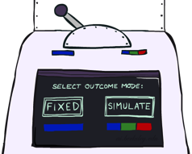
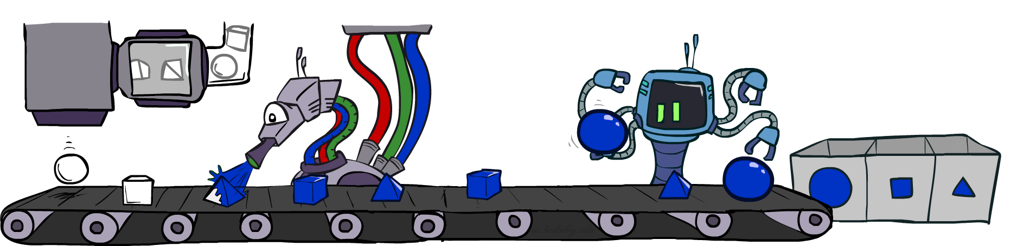

Likelihood Weighting
IN: evidence instantiation
w = 1.0
for i=1, 2, …, n
if X_{i} is an evidence variable
X_{i} = observation x_{i} for X_{i}
Set w = w * P(x_{i} | Parents(X_{i}))
else
Sample x_{i} from P(X_{i} | Parents(X_{i}))
return (x₁, x₂, …, x_{n}), w

Slide 4
Likelihood Weighting
No evidence:
Prior Sampling
Some evidence:
Likelihood Weighted Sampling
All evidence:
Likelihood Weighted
Input: no evidence
for i=1, 2, …, n
Sample x_{i} from P(X_{i} | Parents(X_{i}))
return (x₁, x₂, …, x_{n})
Input: evidence instantiation
w = 1.0
for i=1, 2, …, n
if X_{i} is an evidence variable
X_{i} = observation x_{i} for X_{i}
Set w = w * P(x_{i} | Parents(X_{i}))
else
Sample x_{i} from P(X_{i} | Parents(X_{i}))
return (x₁, x₂, …, x_{n}), w
Input: evidence instantiation
w = 1.0
for i=1, 2, …, n
Set w = w * P(x_{i} | Parents(X_{i}))
return w

Slide 5


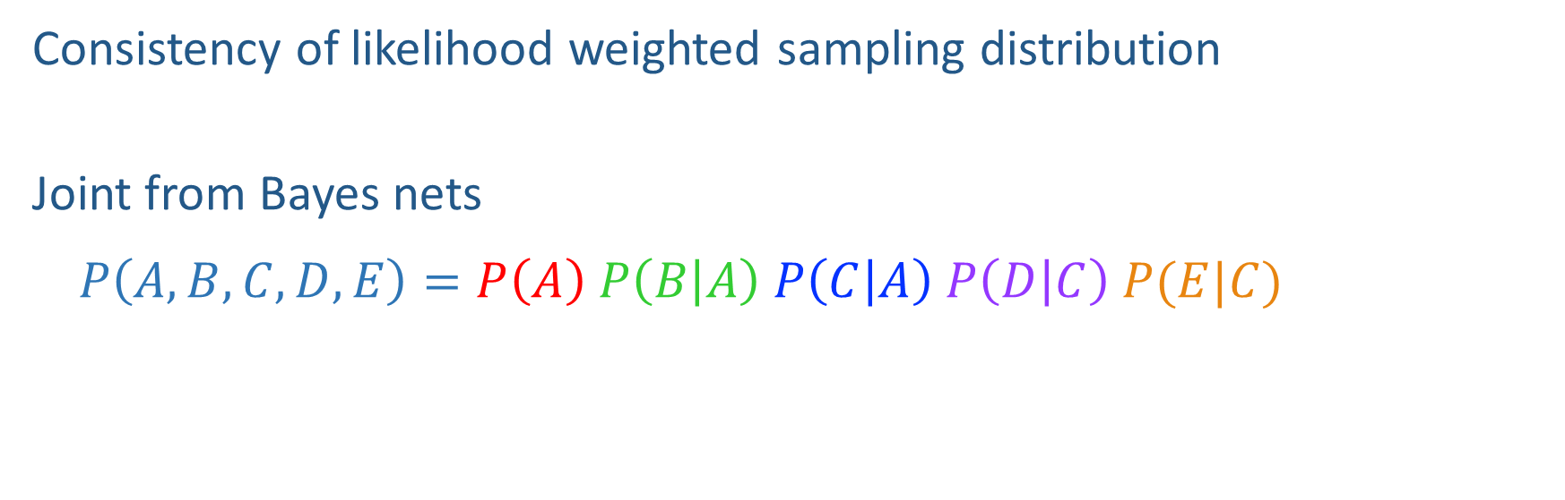

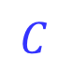

Likelihood Weighting Distribution
$$A$$
Consistency of likelihood weighted sampling distribution
Joint from Bayes nets
$$P\left(A,B,C,D,E\right)=P\left(A\right) P\left(B | A\right) P\left(C | A\right) P\left(D | C\right) P(E|C)$$
$$B$$
$$C$$
$$D$$
$$E$$

Slide 6
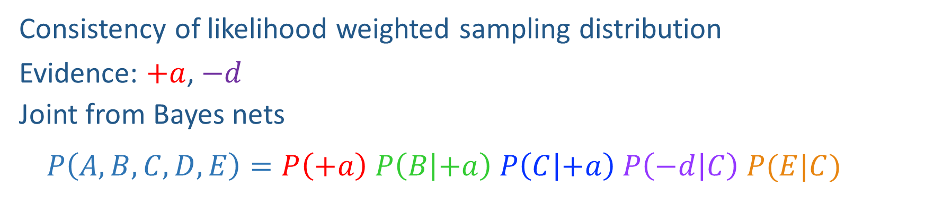

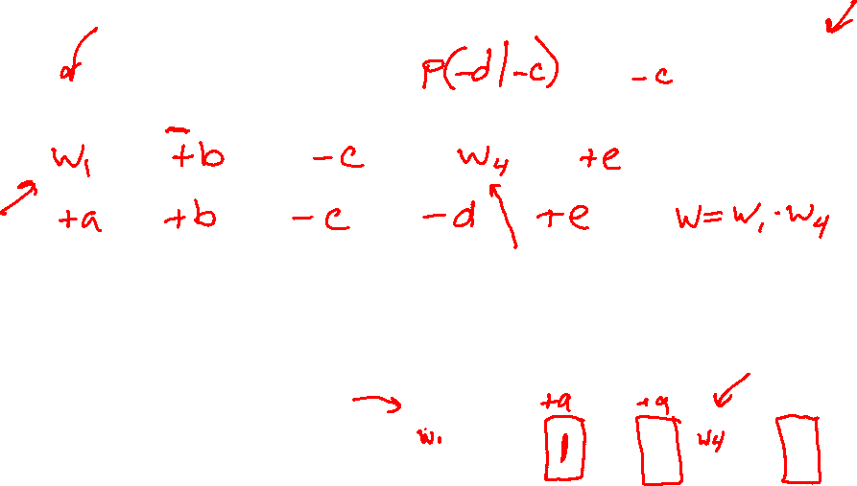
Likelihood Weighting Distribution
$$A$$
Consistency of likelihood weighted sampling distribution
Evidence: $+a$, $−d$
Joint from Bayes nets
$$P\left(A,B,C,D,E\right)=P\left(+a\right) P\left(B | +a\right) P\left(C | +a\right) P\left(−d | C\right) P(E|C)$$
$$B$$
$$C$$
$$D$$
$$E$$

Slide 7
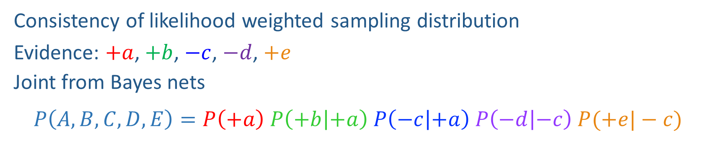
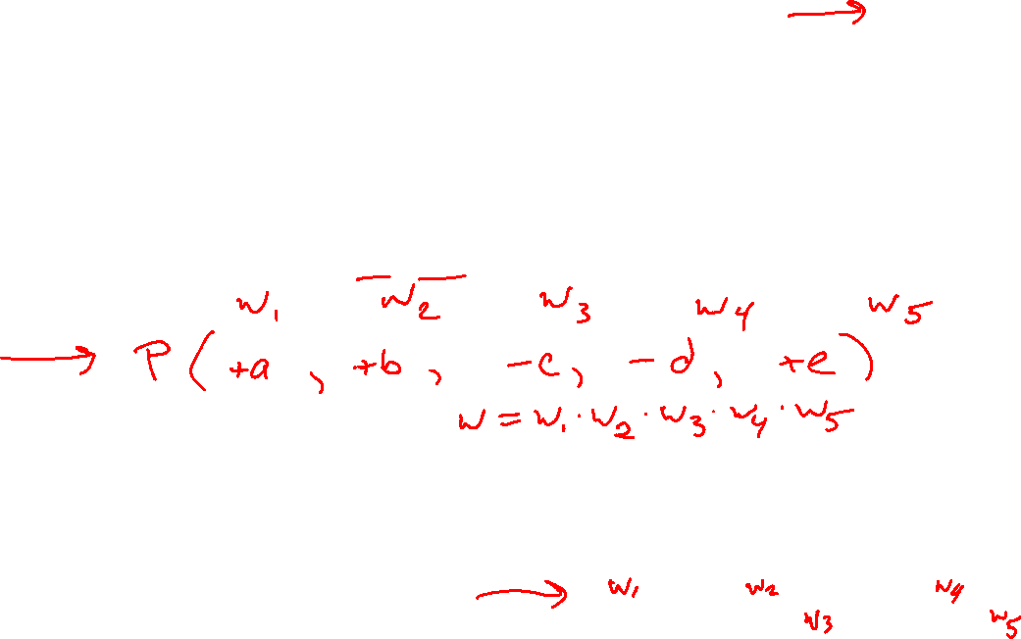
Likelihood Weighting Distribution
$$A$$
Consistency of likelihood weighted sampling distribution
Evidence: $+a$, $+b$, $−c$, $−d$, $+e$
Joint from Bayes nets
$$P\left(A,B,C,D,E\right)=P\left(+a\right) P\left(+b | +a\right) P\left(−c | +a\right) P\left(−d | −c\right) P(+e|−c)$$
$$B$$
$$C$$
$$D$$
$$E$$

Slide 8

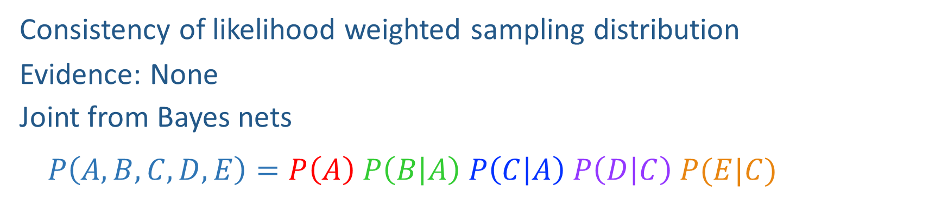
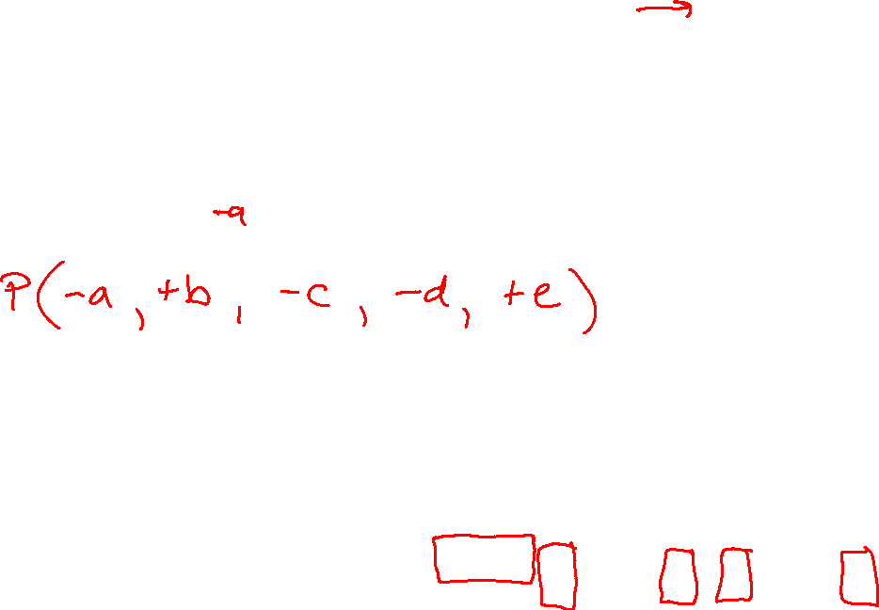
Likelihood Weighting Distribution
$$A$$
Consistency of likelihood weighted sampling distribution
Evidence: None
Joint from Bayes nets
$$P\left(A,B,C,D,E\right)=P\left(A\right) P\left(B | A\right) P\left(C | A\right) P\left(D | C\right) P(E|C)$$
$$B$$
$$C$$
$$D$$
$$E$$

Slide 9
Piazza Poll 1
Two identical samples from likelihood weighted sampling will have the same exact weights.
True
False
It depends
I don’t know

Slide 10
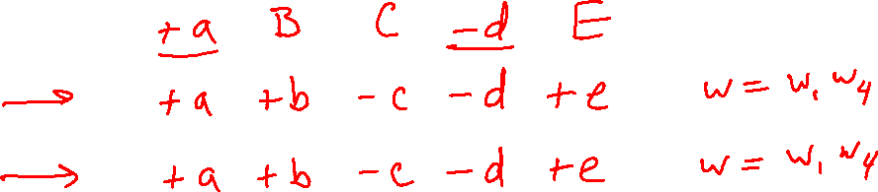

Piazza Poll 1
Two identical samples from likelihood weighted sampling will have the same exact weights.
True
False
It depends
I don’t know

Slide 11
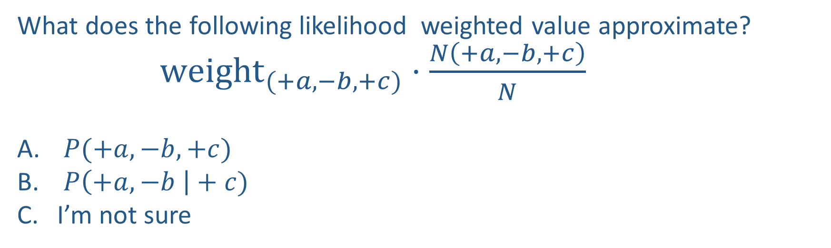
Piazza Poll 2
What does the following likelihood weighted value approximate?
${weight}_{(+a,−b,+c)}⋅\frac{N\left(+a, −b, +c\right)}{N}$
$P(+a, −b, +c)$
$P\left(+a, −b \right|+c)$
I’m not sure

Slide 12
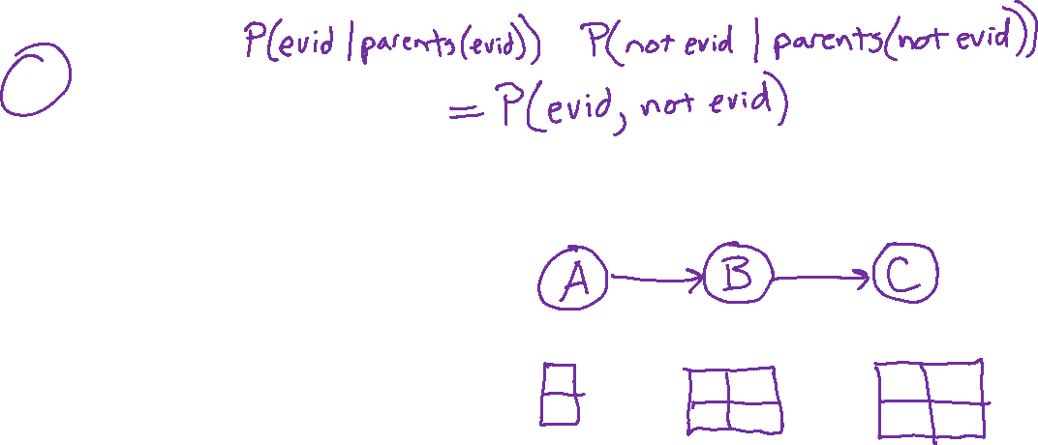
Piazza Poll 2
What does the following likelihood weighted value approximate?
${weight}_{(+a,−b,+c)}⋅\frac{N\left(+a, −b, +c\right)}{N}$
$P(+a, −b, +c)$
$P\left(+a, −b \right|+c)$
I’m not sure

Slide 13
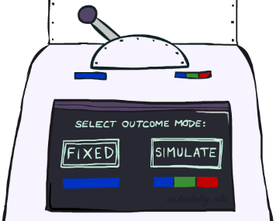
Likelihood Weighting
Likelihood weighting is good
We have taken evidence into account as we generate the sample
E.g. here, W’s value will get picked based on the evidence values of S, R
More of our samples will reflect the state of the world suggested by the evidence
Likelihood weighting doesn’t solve all our problems
Evidence influences the choice of downstream variables, but not upstream ones (C isn’t more likely to get a value matching the evidence)
We would like to consider evidence when we sample every variable

Slide 14
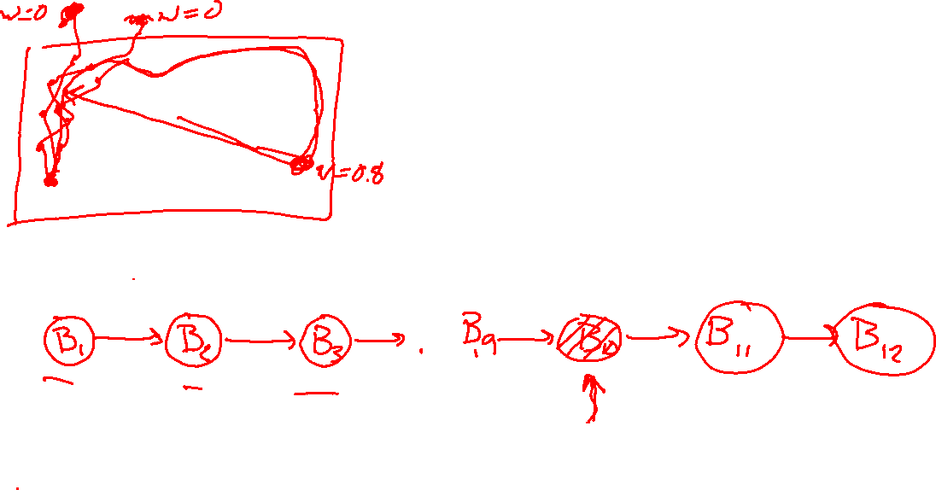
Likelihood Weighting
Likelihood weighting doesn’t solve all our problems
Evidence influences the choice of downstream variables, but not upstream ones (C isn’t more likely to get a value matching the evidence)
We would like to consider evidence when we sample every variable
→ Gibbs sampling

Slide 15

Gibbs Sampling

Slide 16
Gibbs Sampling
Procedure: keep track of a full instantiation x₁, x₂, …, x_{n}.
Start with an arbitrary instantiation consistent with the evidence.
Sample one variable at a time, conditioned on all the rest, but keep evidence fixed.
Keep repeating this for a long time.

Slide 17

Gibbs Sampling Example: P( S | +r)
Step 1: Fix evidence
R = +r
Steps 3: Repeat
Choose a non-evidence variable X
Resample X from P( X | all other variables)
Step 2: Initialize other variables
Randomly
C
C
S
+r
S
+r
W
W
C
C
C
C
C
C
S
+r
S
+r
S
+r
S
+r
S
+r
S
+r
W
W
W
W
W
W

Slide 18
Gibbs Sampling Example: P( S | +r)
Keep only the last sample from each iteration:
C
C
C
C
C
S
+r
S
+r
S
+r
S
+r
S
+r
W
W
W
W
W
C
C
C
C
C
S
+r
S
+r
S
+r
S
+r
S
+r
W
W
W
W
W
C
C
C
C
C
S
+r
S
+r
S
+r
S
+r
S
+r
W
W
W
W
W

Slide 19
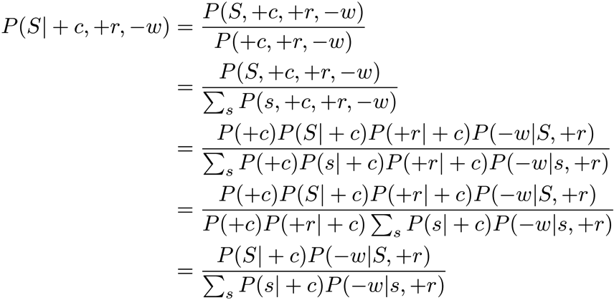
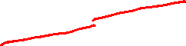

Efficient Resampling of One Variable
Sample from P(S | +c, +r, -w)
Many things cancel out – only CPTs with S remain!
More generally: only CPTs that have resampled variable need to be considered, and joined together
C
S
+r
W

Slide 20

Gibbs Sampling
Procedure: keep track of a full instantiation x₁, x₂, …, x_{n}.
Start with an arbitrary instantiation consistent with the evidence.
Sample one variable at a time, conditioned on all the rest, but keep evidence fixed.
Keep repeating this for a long time.
Property: in the limit of repeating this infinitely many times the resulting sample is coming from the correct distribution
Rationale: both upstream and downstream variables condition on evidence.
In contrast: likelihood weighting only conditions on upstream evidence, and hence weights obtained in likelihood weighting can sometimes be very small. Sum of weights over all samples is indicative of how many “effective” samples were obtained, so want high weight.

Slide 21
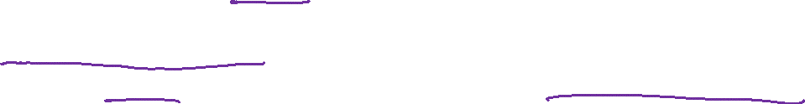
Gibbs Sampling
Gibbs sampling produces sample from the query distribution P( Q | e ) in limit of re-sampling infinitely often
Gibbs sampling is a special case of more general methods called Markov chain Monte Carlo (MCMC) methods
Metropolis-Hastings is one of the more famous MCMC methods (in fact, Gibbs sampling is a special case of Metropolis-Hastings)
You may read about Monte Carlo methods – they’re just sampling

Slide 22
Markov Chain Monte Carlo*
Idea: instead of sampling from scratch, create samples that are each like the last one.
Procedure: resample one variable at a time, conditioned on all the rest, but keep evidence fixed. E.g., for P(b|c):
Properties: Now samples are not independent (in fact they’re nearly identical), but sample averages are still consistent estimators!
What’s the point: both upstream and downstream variables condition on evidence.
+b
+a
+c
-b
+a
+c
-b
-a
+c

Slide 23
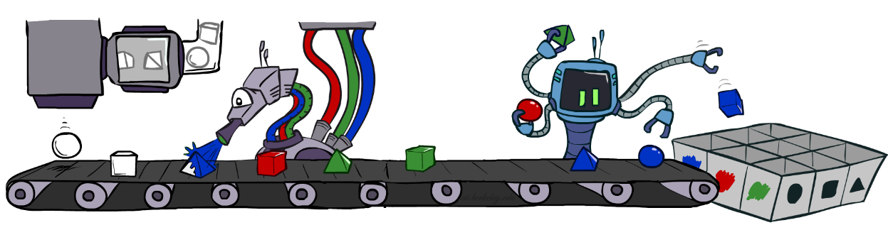
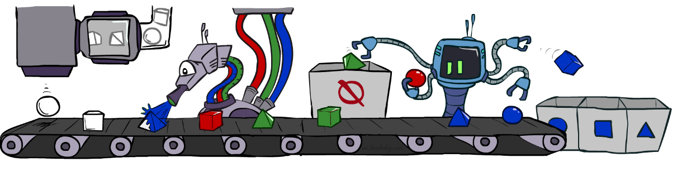

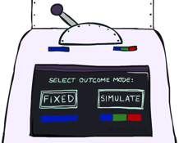


Bayes’ Net Sampling Summary
Prior Sampling P(Q, E)
Likelihood Weighting P( Q , e)
Rejection Sampling P( Q | e )
Gibbs Sampling P( Q | e )

Slide 24
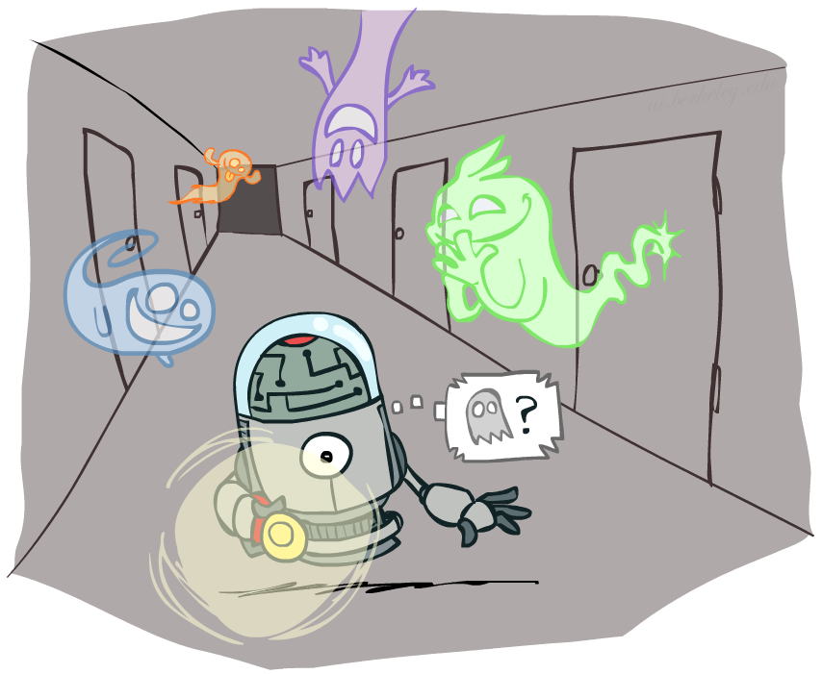
AI: Representation and Problem Solving
Hidden Markov Models
Instructors: Pat Virtue & Stephanie Rosenthal
Slide credits: CMU AI and http://ai.berkeley.edu

Slide 25
Reasoning over Time or Space
Often, we want to reason about a sequence of observations
Speech recognition
Robot localization
User attention
Medical monitoring
Need to introduce time (or space) into our models

Slide 26
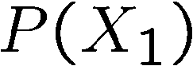
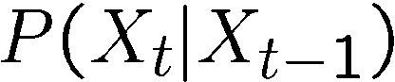

Markov Models
Value of X at a given time is called the state
Parameters: called transition probabilities or dynamics, specify how the state evolves over time (also, initial state probabilities)
Stationarity assumption: transition probabilities the same at all times
Same as MDP transition model, but no choice of action
X₁
X₂
X₃
X₄

Slide 27


Conditional Independence
Basic conditional independence:
Past and future independent given the present
Each time step only depends on the previous
This is called the (first order) Markov property
Note that the chain is just a (growable) BN
We can always use generic BN reasoning on it if we truncate the chain at a fixed length

Slide 28
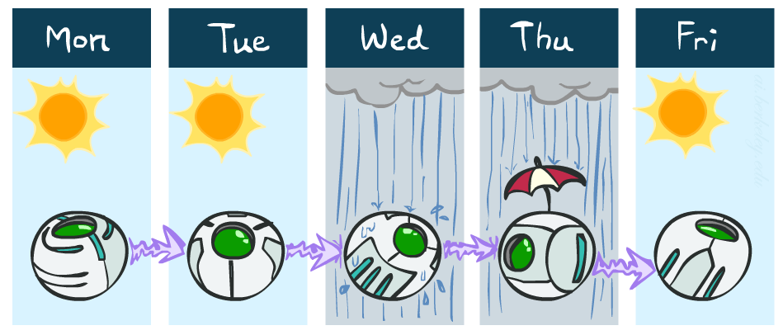
Example Markov Chain: Weather
States: X = {rain, sun}
Initial distribution: 1.0 sun
CPT P(X_{t} | X_{t-1}):
Two new ways of representing the same CPT
X_{t-1} | X_{t} | P(X_{t}|X_{t-1})
sun | sun | 0.9
sun | rain | 0.1
rain | sun | 0.3
rain | rain | 0.7
0.9
0.3
0.9
rain
sun
sun
sun
0.1
0.3
rain
rain
0.7
0.7
0.1

Slide 29
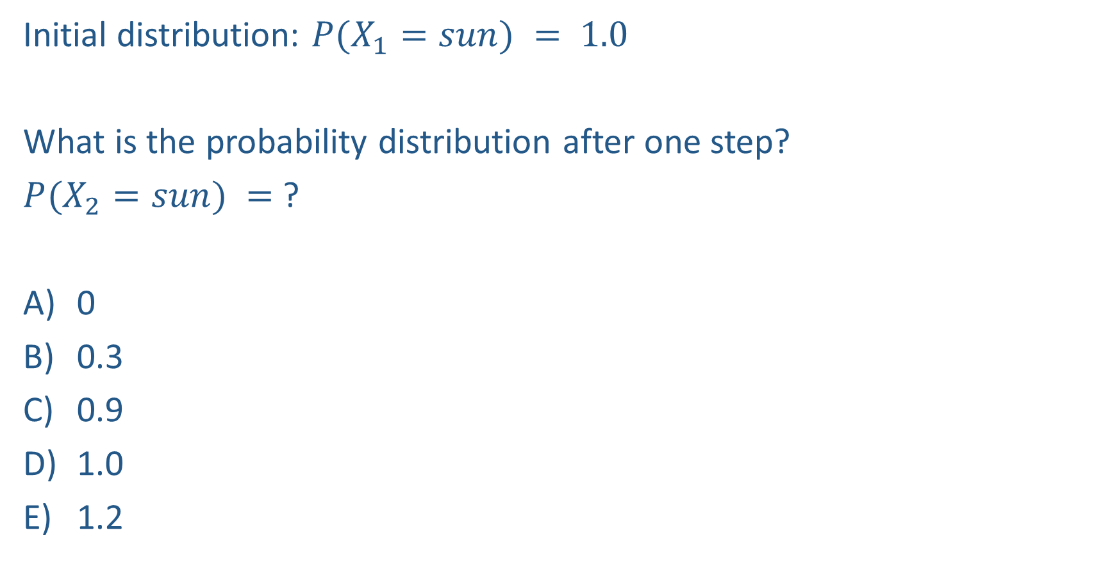
Piazza Poll 3
0.9
0.3
rain
sun
Initial distribution: $P(X_{1}=sun) = 1.0$
What is the probability distribution after one step?
$P(X_{2}=sun) =$ ?
0
0.3
0.9
1.0
1.2
0.7
0.1

Slide 30

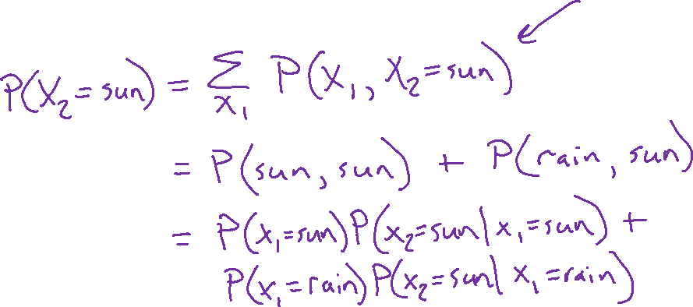
Piazza Poll 3
0.9
0.3
rain
sun
Initial distribution: $P(X_{1}=sun) = 1.0$
What is the probability distribution after one step?
$P(X_{2}=sun) =$ ?
0
0.3
0.9
1.0
1.2
0.7
0.1

Slide 31
Piazza Poll 3
0.9
0.3
rain
sun
Initial distribution: $P(X_{1}=sun) = 1.0$
What is the probability distribution after one step?
$P(X_{2}=sun) =$ ?
0
0.3
0.9
1.0
1.2
0.7
0.1

Slide 32
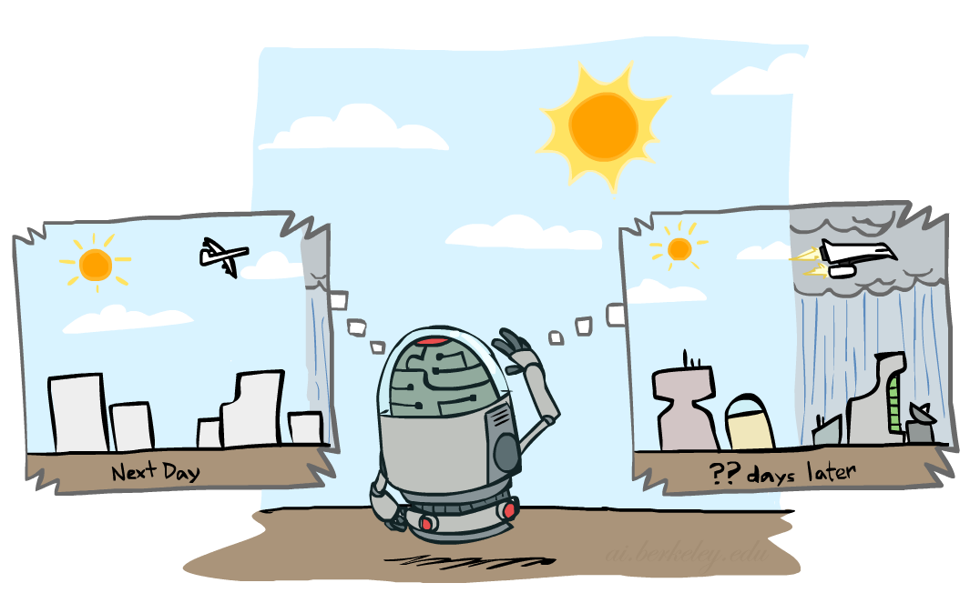

Mini-Forward Algorithm
Question: What’s P(X) on some day t?
X₁
X₂
X₃
X₄
Forward simulation

Slide 33
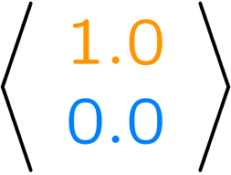
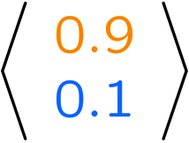
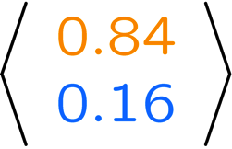
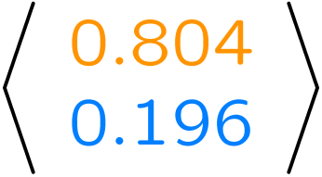
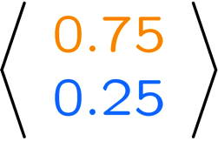
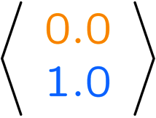
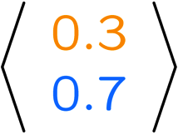
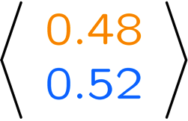
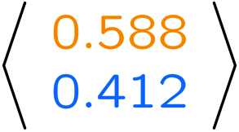
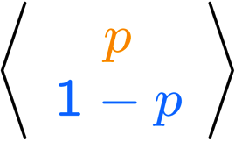
Example Run of Mini-Forward Algorithm
From initial observation of sun
From initial observation of rain
From yet another initial distribution P(X₁):
P(X₁)
P(X₂)
P(X₃)
P(X₄)
P(X∞)
P(X₁)
P(X₂)
P(X₃)
P(X₄)
P(X∞)
…
P(X₁)
P(X∞)
[Demo: L13D1,2,3]

Slide 34
Demo Ghostbusters Basic Dynamics

Slide 35
Demo Ghostbusters Circular Dynamics

Slide 36
Demo Ghostbusters Whirlpool Dynamics

Slide 37

Stationary Distributions
For most chains:
Influence of the initial distribution gets less and less over time.
The distribution we end up in is independent of the initial distribution
Stationary distribution:
The distribution we end up with is called the stationary distribution of the chain
It satisfies

Slide 38

Example: Stationary Distributions
Question: What’s P(X) at time t = infinity?
X₁
X₂
X₃
X₄
X_{t-1} | X_{t} | P(X_{t}|X_{t-1})
sun | sun | 0.9
sun | rain | 0.1
rain | sun | 0.3
rain | rain | 0.7
Also:

Slide 39
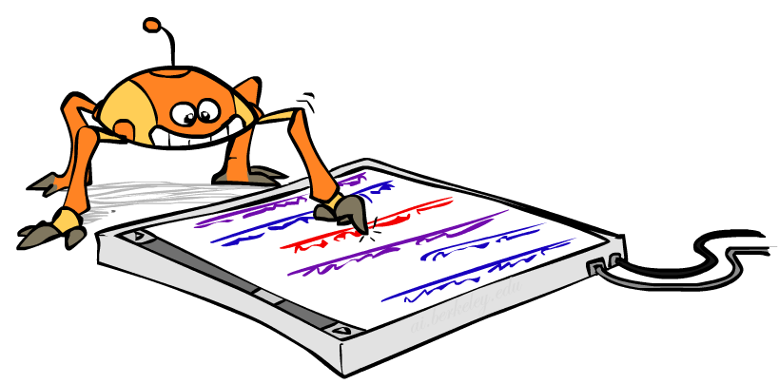
Application of Stationary Distribution: Web Link Analysis
PageRank over a web graph
Each web page is a state
Initial distribution: uniform over pages
Transitions:
With prob. c, uniform jump to a
random page (dotted lines, not all shown)
With prob. 1-c, follow a random
outlink (solid lines)
Stationary distribution
Will spend more time on highly reachable pages
E.g. many ways to get to the Acrobat Reader download page
Somewhat robust to link spam
Google 1.0 returned the set of pages containing all your keywords in decreasing rank, now all search engines use link analysis along with many other factors (rank actually getting less important over time)
Notes:
Before: most search engines were merely based on how well a page matches your search words.
Note: currently dominated by clickstreams

Slide 40
Application of Stationary Distributions: Gibbs Sampling*
Each joint instantiation over all hidden and query variables is a state: {X₁, …, X_{n}} = H U Q
Transitions:
With probability 1/n resample variable X_{j} according to
P(X_{j} | x₁, x₂, …, x_{j-1,} x_{j+1}, …, x_{n,} e_{1,} …, e_{m})
Stationary distribution:
Conditional distribution P(X₁, X₂ , … , X_{n}|e_{1,} …, e_{m})
Means that when running Gibbs sampling long enough we get a sample from the desired distribution
Requires some proof to show this is true!
Notes:
With re-ordering of topics, can’t cover this here yet, need to wait till after sampling.

Slide 41
Quick Break
How the real Ghostbusters make decisions

Slide 42

Hidden Markov Models

Slide 43
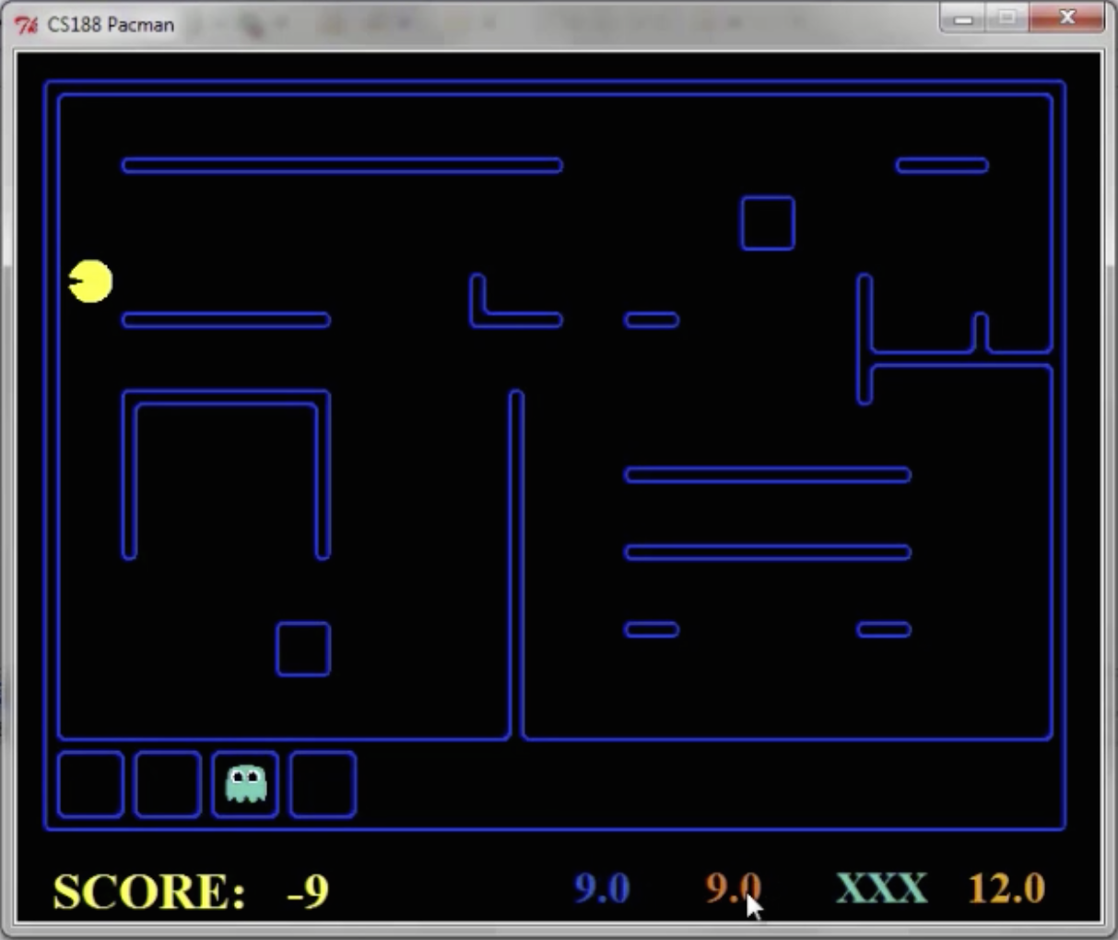
Pacman – Sonar (P5)
[Demo: Pacman – Sonar – No Beliefs(L14D1)]

Slide 44
Demo Pacman – Sonar (no beliefs)

Slide 45
Hidden Markov Models
Markov chains not so useful for most agents
Need observations to update your beliefs
Hidden Markov models (HMMs)
Underlying Markov chain over states X
You observe outputs (effects) at each time step
X₁
X₂
X₃
X₄
X₅
E₁
E₂
E₃
E₄
E₅

Slide 46

Dynamic Bayes Nets (DBNs)
We want to track multiple variables over time, using multiple sources of evidence
Idea: Repeat a fixed Bayes net structure at each time
Variables from time t can condition on those from t-1
t =1
t =2
t =3
G₁ª
G₂ª
G₃ª
G₁^{b}
G₂^{b}
G₃^{b}
E₁ª
E₁^{b}
E₂ª
E₂^{b}
E₃ª
E₃^{b}

Slide 47



Example: Weather HMM
Rain_{t-1}
Rain_{t}
Rain_{t+1}
Umbrella_{t-1}
Umbrella_{t}
Umbrella_{t+1}
An HMM is defined by:
Initial distribution:
Transitions:
Emissions:
R_{t-1} | R_{t} | P(R_{t}|R_{t-1})
+r | +r | 0.7
+r | -r | 0.3
-r | +r | 0.3
-r | -r | 0.7
R_{t} | U_{t} | P(U_{t}|R_{t})
+r | +u | 0.9
+r | -u | 0.1
-r | +u | 0.2
-r | -u | 0.8
Notes:
demo

Slide 48


Example: Ghostbusters HMM
P(X₁) = uniform
P(X|X’) = usually move clockwise, but sometimes move in a random direction or stay in place
P(R_{ij}|X) = same sensor model as before: red means close, green means far away.
1/9
1/9
1/9
1/9
1/9
1/9
1/9
1/9
1/9
P(X₁)
1/6
1/6
1/2
0
1/6
0
X₁
X₂
X₃
X₄
0
0
0
X₅
P(X|X’=<1,2>)
R_{i,j}
R_{i,j}
R_{i,j}
R_{i,j}
[Demo: Ghostbusters – Circular Dynamics – HMM (L14D2)]
Notes:
Dan has some demo for this.

Slide 49
Demo Ghostbusters – Circular Dynamics -- HMM

Slide 50
Conditional Independence
HMMs have two important independence properties:
Markov hidden process: future depends on past via the present
Current observation independent of all else given current state
Does this mean that evidence variables are guaranteed to be independent?
[No, they tend to correlated by the hidden state]
X₁
X₂
X₃
X₄
X₅
E₁
E₂
E₃
E₄
E₅

Slide 51
Real HMM Examples
Speech recognition HMMs:
Observations are acoustic signals (continuous valued)
States are specific positions in specific words (so, tens of thousands)
Machine translation HMMs:
Observations are words (tens of thousands)
States are translation options
Robot tracking:
Observations are range readings (continuous)
States are positions on a map (continuous)

Slide 52
Filtering / Monitoring
Filtering, or monitoring, is the task of tracking the distribution B_{t}(X) = P_{t}(X_{t} | e₁, …, e_{t}) (the belief state) over time
We start with B₁(X) in an initial setting, usually uniform
As time passes, or we get observations, we update B(X)
The Kalman filter was invented in the 60’s and first implemented as a method of trajectory estimation for the Apollo program
Notes:
Dan has some demo for this

Slide 53
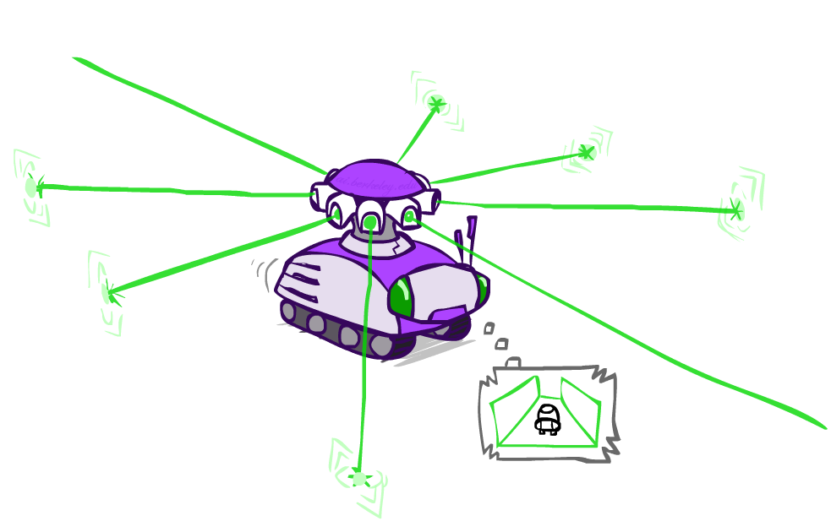
Example: Robot Localization
Example from Michael Pfeiffer
Prob
0
1
t=0
Sensor model: can read in which directions there is a wall, never more than 1 mistake
Motion model: may not execute action with small prob.

Slide 54
Example: Robot Localization
Prob
0
1
t=1
Lighter grey: was possible to get the reading, but less likely b/c required 1 mistake

Slide 55
Example: Robot Localization
Prob
0
1
t=2

Slide 56
Example: Robot Localization
Prob
0
1
t=3

Slide 57
Example: Robot Localization
Prob
0
1
t=4

Slide 58
Example: Robot Localization
Prob
0
1
t=5

Slide 59
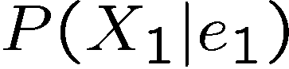
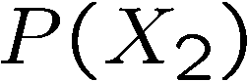
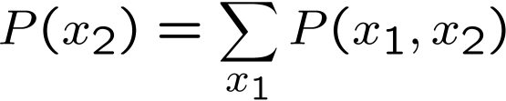
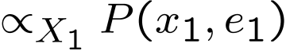
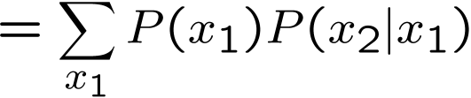
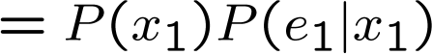

Inference: Base Cases
X₁
X₁
X₂
E₁

Slide 60
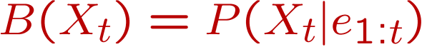
Passage of Time
Assume we have current belief P(X | evidence to date)
Then, after one time step passes:
Basic idea: beliefs get “pushed” through the transitions
With the “B” notation, we have to be careful about what time step t the belief is about, and what evidence it includes
X₁
X₂
Or compactly:
Notes:
TODO: intermediate step in derivation!

Slide 61

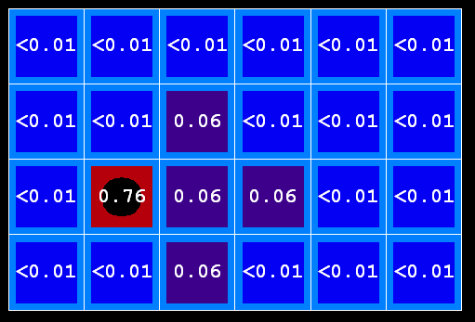
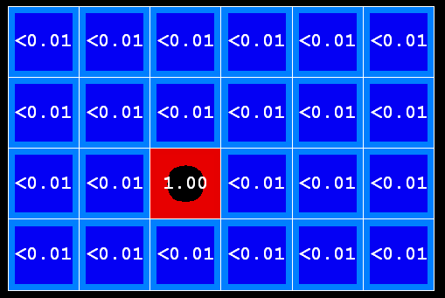

Example: Passage of Time
As time passes, uncertainty “accumulates”
(Transition model: ghosts usually go clockwise)
T = 1
T = 2
T = 5

Slide 62
Observation
Assume we have current belief P(X | previous evidence):
Then, after evidence comes in:
Or, compactly:
X₁
E₁
Basic idea: beliefs “reweighted” by likelihood of evidence
Unlike passage of time, we have to renormalize
Notes:
Basic idea: beliefs “reweighted” by likelihood of evidence
Unlike passage of time, we have to renormalize

Slide 63




Example: Observation
As we get observations, beliefs get reweighted, uncertainty “decreases”
Before observation
After observation

Slide 64
Example: Weather HMM
B’(+r) = 0.5
B’(-r) = 0.5
B’(+r) = 0.627
B’(-r) = 0.373
B(+r) = 0.5
B(-r) = 0.5
B(+r) = 0.818
B(-r) = 0.182
B(+r) = 0.883
B(-r) = 0.117
Rain₀
Rain₁
Rain₂
R_{t} | R_{t+1} | P(R_{t+1}|R_{t})
+r | +r | 0.7
+r | -r | 0.3
-r | +r | 0.3
-r | -r | 0.7
R_{t} | U_{t} | P(U_{t}|R_{t})
+r | +u | 0.9
+r | -u | 0.1
-r | +u | 0.2
-r | -u | 0.8
Umbrella₁
Umbrella₂
Notes:
demo

Slide 65
Other HMM Queries
Filtering: P(X_{t}|e_{1:t})
Prediction: P(X_{t}|e_{1:t-1})
X₁
X₂
X₃
X₄
X₁
X₂
X₃
X₄
e₁
e₂
e₃
e₄
e₁
e₂
e₃
Smoothing: P(X_{t}|e_{1:N}), t<N
Explanation: P(X_{1:N}|e_{1:N})
X₁
X₂
X₃
X₄
X₁
X₂
X₃
X₄
e₁
e₂
e₃
e₄
e₁
e₂
e₃
e₄

Slide 66
The Forward Algorithm
Query: What is the current state, given all of the current and past evidence?
Matching math with Bayes net
X₁
X₂
X₃
X₄
e₁
e₂
e₃
e₄
Notes:
Explain propto

Slide 67
The Forward Algorithm
Query: What is the current state, given all of the current and past evidence?
Matching math with Bayes net
X₁
X₂
X₃
X₄
e₁
e₂
e₃
e₄

Slide 68
The Forward Algorithm
Query: What is the current state, given all of the current and past evidence?
Matching math with Bayes net
X₁
X₂
X₃
X₄
e₁
e₂
e₃
e₄

Slide 69
The Forward Algorithm
Query: What is the current state, given all of the current and past evidence?
Matching math with Bayes net
Recursive
X₁
X₂
X₃
X₄
e₁
e₂
e₃
e₄

Slide 70
The Forward Algorithm
Query: What is the current state, given all of the current and past evidence?
Matching math with Bayes net
X₁
X₂
X₃
X₄
e₁
e₂
e₃
e₄

Slide 71
The Forward Algorithm
Query: What is the current state, given all of the current and past evidence?
Marching forward through the HMM network
X₁
X₂
e₁
e₂

Slide 72
The Forward Algorithm
Query: What is the current state, given all of the current and past evidence?
Marching forward through the HMM network
X₁
X₂
X₃
e₁
e₂
e₃

Slide 73
The Forward Algorithm
Query: What is the current state, given all of the current and past evidence?
Marching forward through the HMM network
X₁
X₂
X₃
X₄
e₁
e₂
e₃
e₄

Slide 74
The Forward Algorithm
Query: What is the current state, given all of the current and past evidence?
Marching forward through the HMM network
X₁
X₂
X₃
X₄
e₁
e₂
e₃
e₄

Slide 75
Online Belief Updates
Every time step, we start with current P(X | evidence)
We update for time:
We update for evidence:
The forward algorithm does both at once (and doesn’t normalize)
X₁
X₂
X₂
E₂

Slide 76

Pacman – Sonar (P5)
[Demo: Pacman – Sonar – No Beliefs(L14D1)]

Slide 77
Video of Demo Pacman – Sonar (with beliefs)

Slide 78
Other HMM Queries
Filtering: P(X_{t}|e_{1:t})
Prediction: P(X_{t}|e_{1:t-1})
X₁
X₂
X₃
X₄
X₁
X₂
X₃
X₄
e₁
e₂
e₃
e₄
e₁
e₂
e₃
Smoothing: P(X_{t}|e_{1:N}), t<N
Explanation: P(X_{1:N}|e_{1:N})
X₁
X₂
X₃
X₄
X₁
X₂
X₃
X₄
e₁
e₂
e₃
e₄
e₁
e₂
e₃
e₄

Slide 79
Next Time: Particle Filtering and Applications of HMMs

